Slide 1
WORDNET BROWSER FOR IPHONE AND IPAD
Arif Muliadi / 207115640

Slide 2
Content
Background and Objective
Scope of Final Project
iPhone & iPad
Objective-C & iPhone SDK
Lexical Database Files
WordNet Browser
Conclusion

Slide 3
Background
Only a few Indonesian Dictionary are available in iTunes
Doesn’t contain Lexical and Semantic Relation

Slide 4
Objective
To make Indonesian WordNet Browser that works on iPhone and iPad

Slide 5
Scope of final project
Make WordNet Browser that will give information about gloss, synonym, hipernim, hiponim, holonim, meronim and antonim
The Lexical Database used is not the concentration of this final project
The iPhone SDK used is version 4.2 and the iOS requirement is 4.0

Slide 6
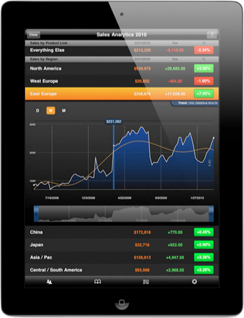
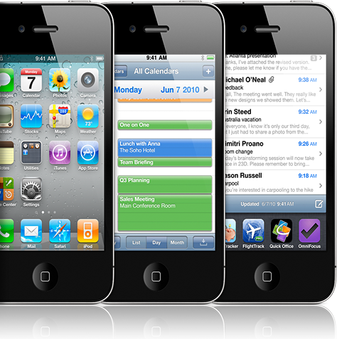
iPhone & iPad

Slide 7
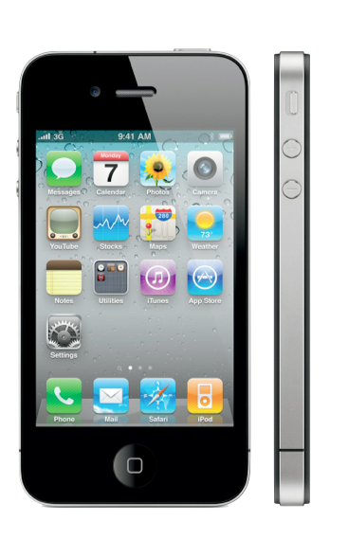
iPhone
Introduced in 2007
Support Multi Touch
Top Selling Mobile Phone

Slide 8
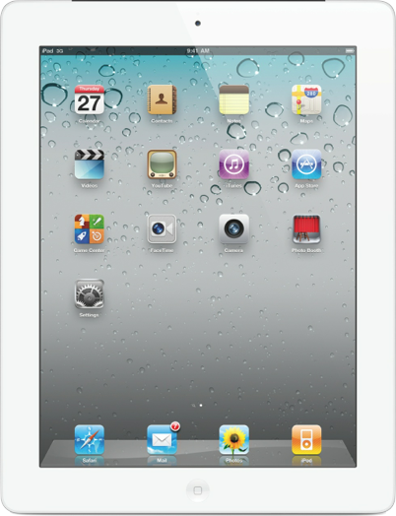
iPad
Introduced in 2010
Rich Multimedia Device
Use iOS

Slide 9

Objective-C & iPhone sdk

Slide 10

Objective-C
Developed 1980s
Primary Language for MacOS & iOS
Object-Oriented

Slide 11

iphone sdk
Integrated in XCode
Use Objective-C Language
Used to develop iPhone and iPad application

Slide 12




XCODE
Xcode application bundle consist of :
Xcode
Interface Builder
Instrument
iPhone Simulator

Slide 13
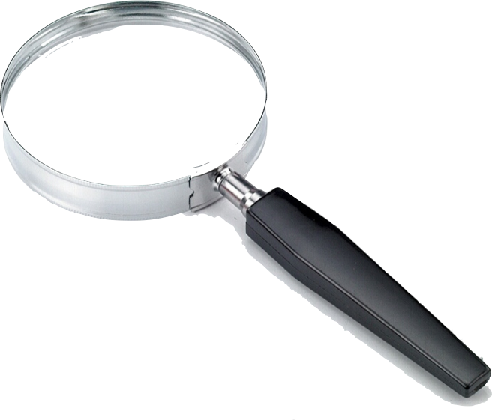
Lexical database files

Slide 14
Lexical database files
Index Files
Data Files
Lexnames File

Slide 15
Index files
Information about how many synsets does a word have
Consists of:
Example Line :
manusia n 5 4 @ ~ #m %p 5 0 05269933 05233006 04637903 04489839 04313370
Index.noun
Index.verb
Index.adverb
Index.adjective

Slide 16
Data files
Information about gloss, relations,synonyms of a synset
Consists of:
Example Line :
05476075 23 n 02 kilo 0 kilogram 2 001 %p 02559717 n 0000 | Satuan pengukuran dalam ukuran 1000 gram. Disingkat kg
Data.noun
Data.verb
Data.adverb
Data.adjective

Slide 17
Lexname file
Information about the type of word
Consists of a single file: lexnames
Example Line :
23 noun.quantity 1

Slide 18
DATA ANALYSIS
Word Class | Number Of Synsets | Number Of Empty Gloss | Empty Gloss Percentage
Noun | 41217 | 4142 | 10.04%
Verb | 20779 | 7710 | 37.07%
Adjective | 7101 | 1998 | 28.14%
Adverb | 653 | 213 | 32.62%

Slide 19
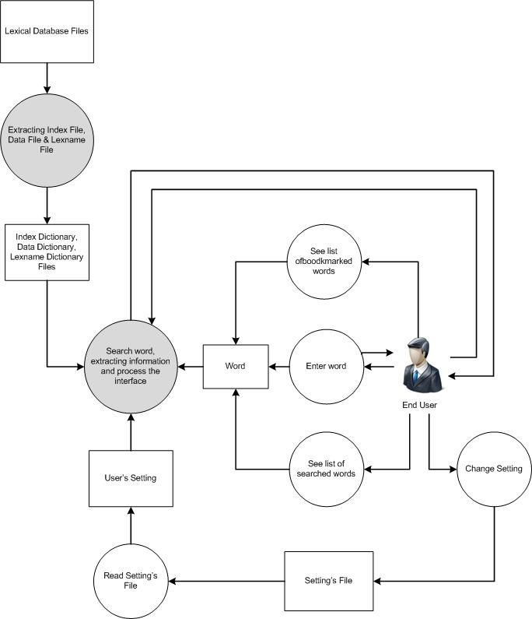
SYSTEM’S ARCHITECTURE

Slide 20
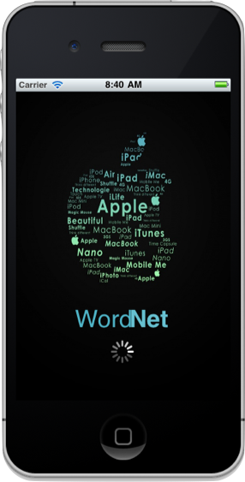
Wordnet browser

Slide 21
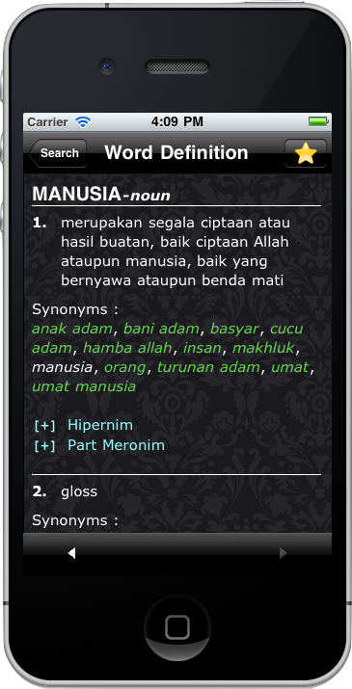
Information specification
Show gloss, synonym
Semantic Relation:
  Hipernim & Hiponim
  Holonim & Meronim
Lexical Relation:
  Antonim

Slide 22
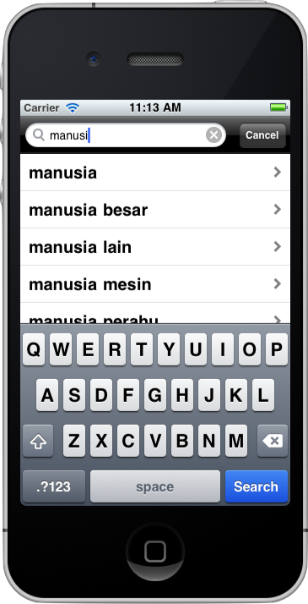
browser Features
Auto Complete

Slide 23
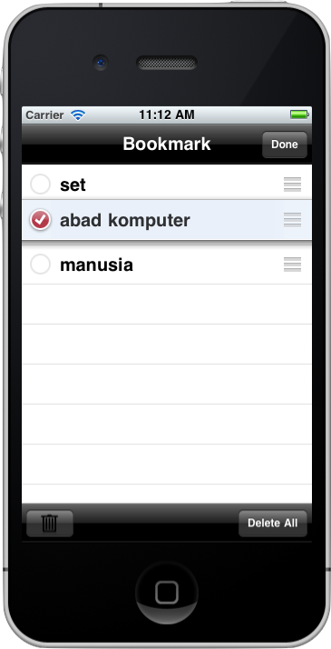
browser Features
Auto Complete
Manageable bookmark and history

Slide 24
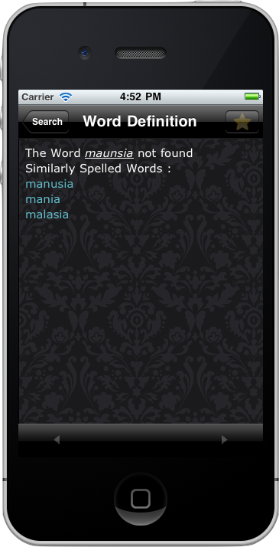
browser Features
Auto Complete
Manageable bookmark and history
Suggestion

Slide 25
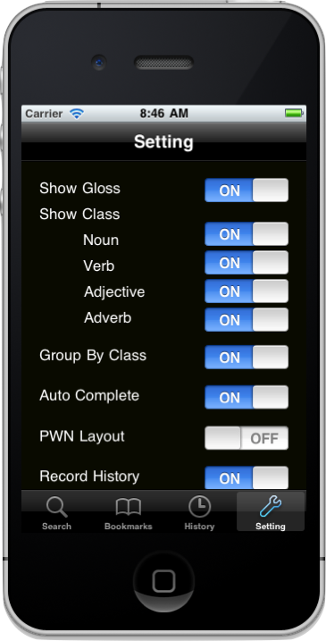
browser Features
Auto Complete
Manageable bookmark and history
Suggestion
Flexible Settings

Slide 26
Conclusion (1)
The habit of iPhone user is important in designing application interface. An abnormal positioning of a button will confuse user.
The usage of C++ will improve the speed of process. This will help when dealing with large amount of data.
Memory Management is very important. Without memory management the memory allocated for the program will quickly run out.

Slide 27
Conclusion (2)
Designing Interface is very important when dealing with large text data. The design have to show full information but not discomforting the user.
Memory leak will make the program run slower. Auto release should be used when declaring a temporary variable.
Instruments provided by Xcode is very useful. Using instrument will help developer detecting memory leak in the application.

Slide 28
Conclusion (3)
WordNet Browser will be able to handle another language. As long as the Lexical Database Files is using the standard rules then the browser won’t have any difficulties.

Slide 29
End Of presentation

